Slide 1
E-commence Financial Security
By Wanwan Zhang

Slide 2
Problem statement
E-commence Negotiation needed to capture better business
Online payment are easy to be attacked
Customer and bank account information
Need the third- party to monitor and guarantee the transcation

Slide 3
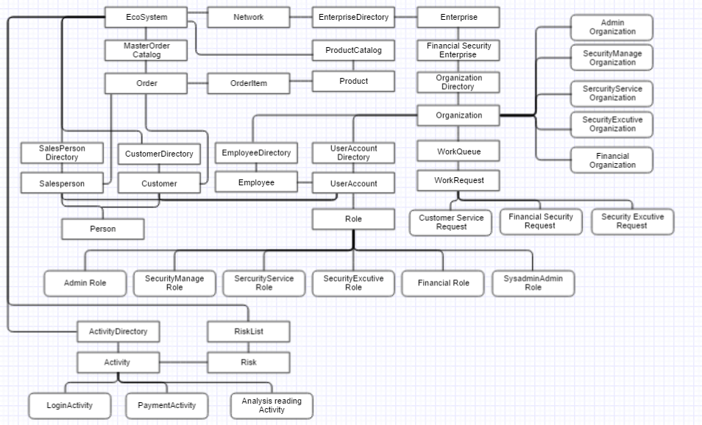
Object Model

Slide 4
E-commence Part –use cases
Admin : manage productcatalog, customer, salesperson, user account, inventory, business analysis (customer behavior analysis, salesperson commission).
Customer : register by self , browse productcatelog, negotiate with salesperson about product price.
Salesperson : negotiate and approved the transaction.
Negotiation
Marketing Analysis

Slide 5
Security enterprise ---use cases
System Admin : Manage enterprises, network
Admin: Manage organizations, User Account, security employee, financial, security manager, excutive , service crew (create , delete , search, view , analysis )
Financial crew : Approve the transaction payment. Manage the bank account and keep the payment safe.
Security Manager : Risk management (Identification, assessment , controls ), process request from excutive.
Security Excutive: Monitor the Activities happened in this application, submit the request of assess of risks. (issue assess)
Security Service : Process the request from customer (partly see the information of customers )

Slide 6
Security Part ----Risk Management
Risk Identification ：
classify and prioritize assets : account information, Payment bank account information, business documentations.
Identify and prioritize threats: the impacts of threats
Risk Assessment:
identify vulnerabilities between asserts and threats.
Identify and quantify assert exposure.
Risk Control : prevent & feedback to Risk.

Slide 7
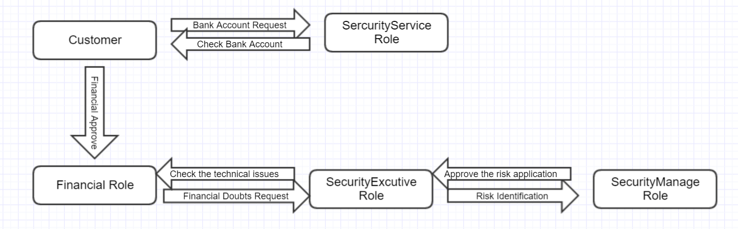
Security Part –human handling workQueue

Slide 8
Security part ----technic
Prevent of Risks:
limited authentication
password specified, limited times login, interval time setting
monitor the login, payment, reading analysis action
partly show the information of account
Feedback of risks :
lock the user
stop the payment actions.

Slide 9
Features assisted in completing the Project.
Polymorphism, inheritance applied in the management of organizations , persons, Roles in useraccount , activities and sessions monitored.
The safe environment (being monitored )
Payment need approved , transaction information protected.
Work queues between security sessions to keep safe financial transaction going.
E-commerce Model.
Push Pull request Model
Analysis and Reporting through JFree Chart
Person and their Roles,Login and Organization
Create, Delete, View and Update Details

Slide 10


